Slide 1
Work with the person next to you
Get a whiteboard…
Together write down 5 words on the HW packet that you did not know or you forgot hat they meant.

Slide 2
Earth Science MCAS Review what else can we expect on the test?

Slide 3
Current Accepted Theory
How did the Moon Form?
A large Mars- sized object collided with Earth while Earth was still forming & part of the mantle was blasted into orbit

Slide 4
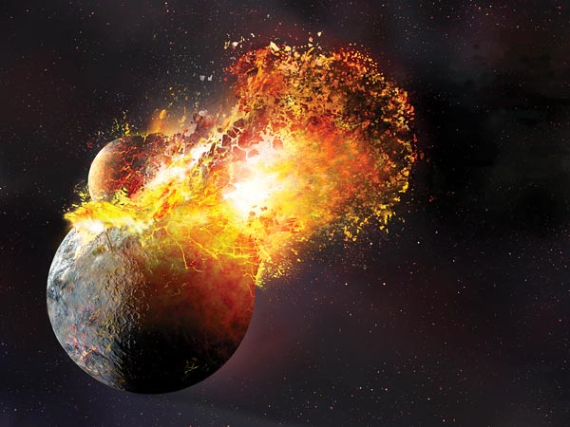

Slide 5
About how many Earth days does it take the Moon to travel around Earth?
A. 1
B. 27
C. 180
D. 365

Slide 6
Our Solar System includes:
The Dwarf Planets
Pluto
Eris
Ceres
Sun
8 planets
"Small Solar-System Bodies"
inner planets
Mercury
Venus
Earth
Mars
outer planets
Jupiter
Saturn
Uranus
Neptune
Asteroids
Comets
Meteors & Meteorites

Slide 7


Outer Solar System
Inner Solar System
4 planets closest to the sun
small & closer together
called terrestrial planets
dense & rocky surfaces
Mercury
Venus
Earth
Mars
4 planets farthest from the sun
large
composed mostly of gases
called gas giants
have rings
Jupiter
Saturn
Neptune
Uranus

Slide 8
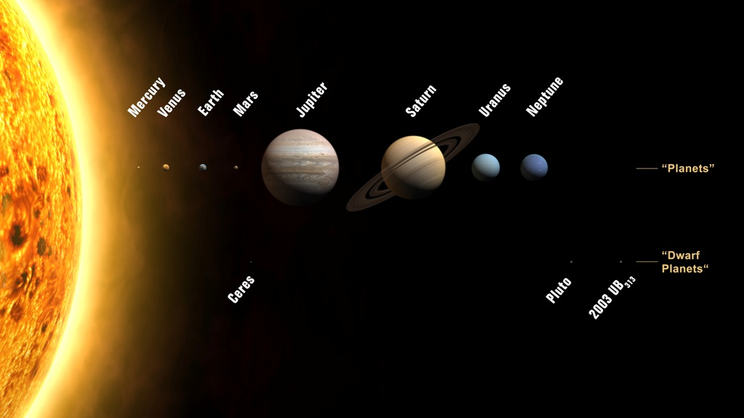
Our Solar System

Slide 9
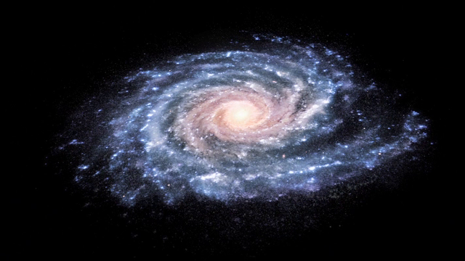
Milky way galaxy

Slide 10
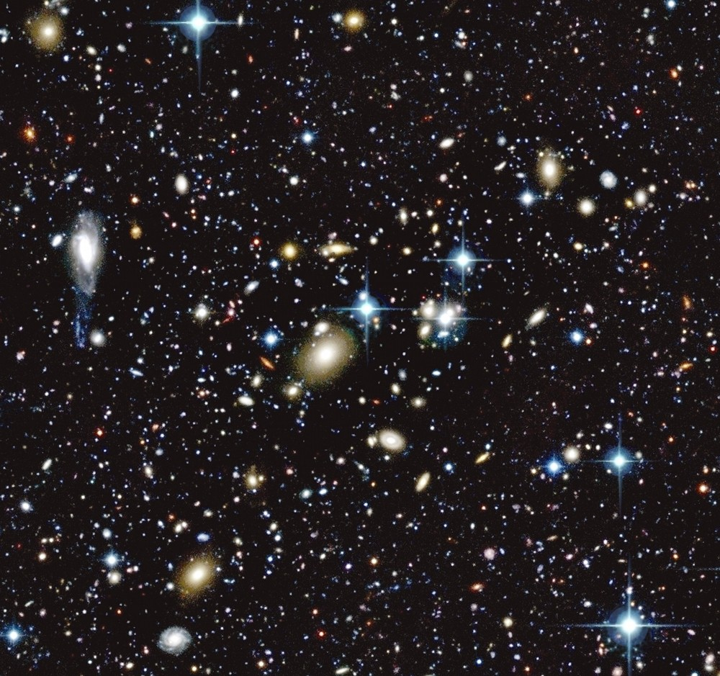

Slide 11
Solar system, galaxy, universe
Which of the following lists is in order from smallest to largest?
A.
B.
C

Slide 12
Which of the following diagrams best represents the relationship between galaxies, the universe, and solar systems

Slide 13
The Moon orbits Earth at a speed of approximately one kilometer per second. The Moon is kept in orbit by which of the following?
A. gravity
B. lunar phases
C. magnetism
D. ocean tides

Slide 14
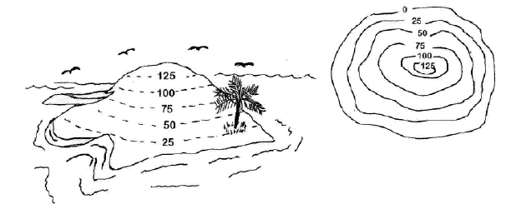
Topographic Map or
Contour Map

Slide 15
Topographic maps show:
the elevation of the land
the steepness of a slope
the shape of the land

Slide 16
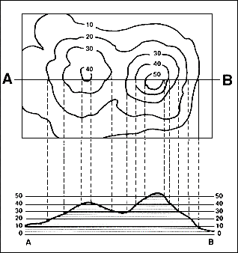

Slide 17
Contour Lines
imaginary lines that connect all points at the same elevation
Contour lines are always parallel.
They never cross.
The closer together the contour lines, the steeper the slope.

Slide 18
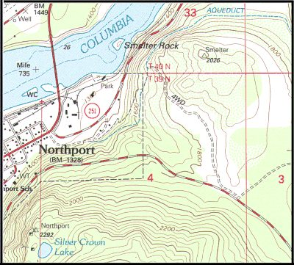
Contour Map

Slide 19
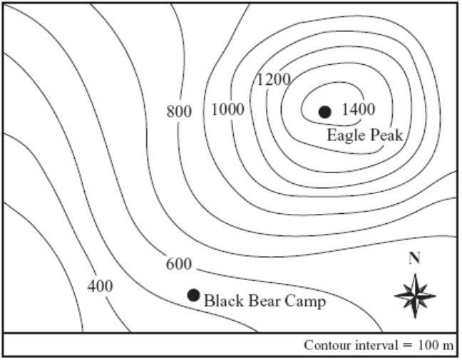
A map with contour lines is shown below
Which of the following is the best estimate of the difference in elevation between Black Bear Camp and Eagle Peak?
A. 400 m
B. 900 m
C. 1200 m
D. 1500 m

Slide 20

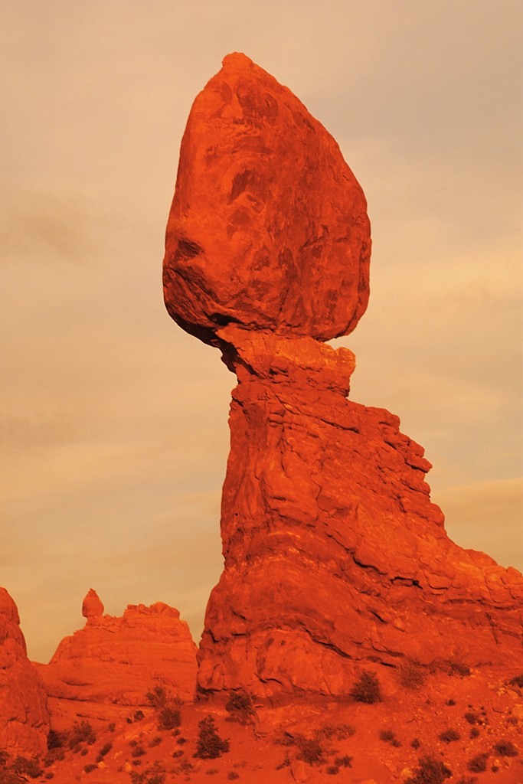
Rocks: Mineral Mixtures
An important natural resource

Slide 21
Rocks
the most common material on Earth
naturally occurring aggregates of one or more minerals
(3) major families
based on how they formed:
igneous
sedimentary
metamorphic

Slide 22
Rock Classification
How it was formed
  igneous, metamorphic, sedimentary
Composition: the chemical makeup of
the rock
3. Texture: quality of the rock based on the
rock’s grains

Slide 23
Igneous Rock
Igneous: made from fire or heat
form when molten rock cools and turns to solid rock
magma: when molten rock is liquid & inside the earth
lava: when the magma gets up to the surface and flows out

Slide 24
Igneous rock question
Where is an igneous rock such as pumice most likely formed?
A. in a desert
B. in a creek bed
C. near a volcano
D. under a glacier

Slide 25
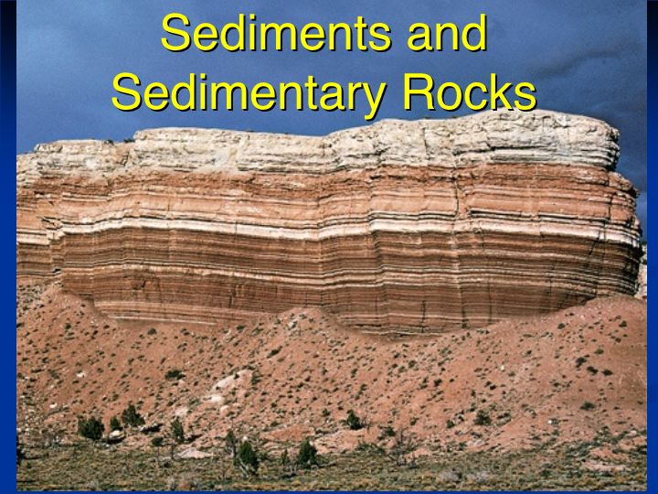
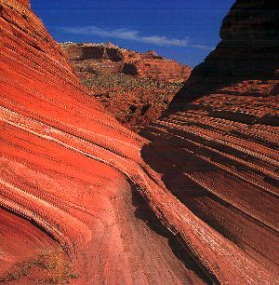
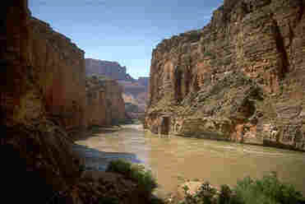
Sedimentary Rocks

Slide 26
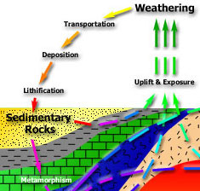
Sedimentary Rock
  Any rock
  (igneous, sedimentary, or metamorphic)
  exposed at the Earth's surface can become a sedimentary rock

Slide 27
How do sedimentary rocks form?
  1) Weathering : process in which water, wind, ice & heat break down rock into sediments
  2) Erosion: process in which water, wind, ice & gravity erode and move sediments
  3) Deposition: process in which sediments move by erosion are dropped and come to rest

Slide 28
How do sedimentary rocks form?
  4) Compaction: new layers push down on old layers, compacting them
  5) Cementation: dissolved minerals in water glue the sediments together

Slide 29
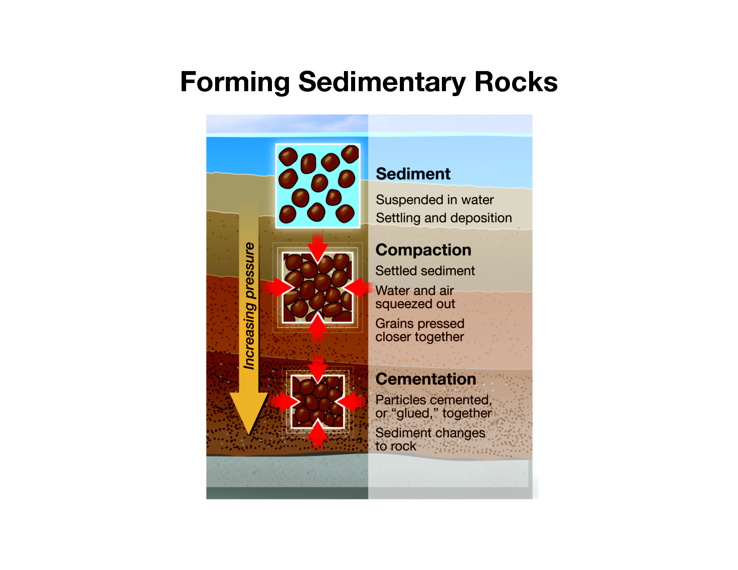

Slide 30
Sedimentary Rock
Stratification: Usually form in strata (layers)
  tells us what the Earth's surface was like in the geologic past
  can contain fossils that tell us about the animals and plants or show the climate in an area
  Sedimentary rocks are also important because they may contain water for drinking or fossil fuel (oil and gas)

Slide 31
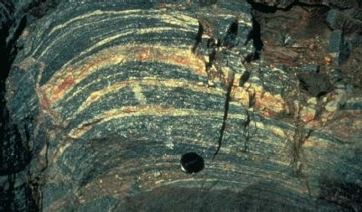
Metamorphic Rock
Any rock (igneous, sedimentary, or metamorphic) can become a metamorphic rock
The term "metamorphic" : to change form
meta = change
morph = shape

Slide 32
Metamorphic Rock
Extreme Temperatures or Pressures are needed:
  Minerals in rock can rearrange themselves into layers or recrystallize
  they are more stable in their new conditions
  All without melting!

Slide 33
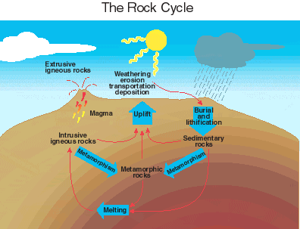

Slide 34
The Rock Cycle

Slide 35
Which of the following areas is most likely to form metamorphic rocks such as gneiss and schist?
A. a sea floor
B. a windblown desert
C. a site deep underground
D. a site covered by a glacier

Slide 36
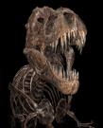

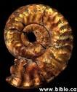

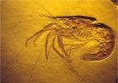
The Rock & Fossil Record

Slide 37
Using Fossils to Interpret the Past
Fossils can tell scientists whether the climate in an area was cooler or wetter in an area than it is at present.
By studying the relationships between fossils, scientists can interpret how life has changed over time.

Slide 38
A researcher found shark fossils on top of a mountain. This evidence suggests which of the following about this region?
  A. It was once below a waterfall.
  B. It was once part of a riverbed.
  C. It was once covered by an ocean.
  D. It was once near a freshwater lake.

Slide 39
The diagram below represents a cross-section of a cliff. It shows several rock layers containing fossils.
Which of the following layers of rock is most likely the youngest?
A. the layer containing trilobites
B. the layer containing fishes
C. the layer containing amphibians
D. the layer containing dinosaur

Slide 40
Using Fossils to Date Rocks
Index fossils :fossils of organisms that lived during a relatively short, well-defined geologic time span
Ammonites - lived between 230 million and 208 million years ago
and
Trilobites - When scientists find they assume that the rock is approximately 400 million years old.

Slide 41
Index fossils help scientists estimate the age of a rock because index fossil species only existed for a relatively short time. What happened to the species that are now used as index fossils?
A. They became extinct.
B. They changed their diets.
C. They hid in marine sediments.
D. They migrated to new environments.

Slide 42
Heat Transfer
Conduction
Convection
Radiation

Slide 43
Thermal energy
aka- (heat energy)
moves from one place to another because of the difference in temperature
The energy transfer is always from hot to cold and it can happen in three ways:
Conduction
Convection
Radiation

Slide 44

Radiation
Radiation does not need fluid, solid or gas to travel through.
Electromagnetic waves that directly transport ENERGY through space.
Sunlight is a form of radiation that is radiated through space to our planet without the aid of fluids or solids. The energy travels through nothingness! Just think of it!

Slide 45

Conduction
Conduction is most effective in solids.
the transfer of energy through matter from particle to particle
or
the transfer and distribution of heat energy from atom to atom within a substance
Electrons become excited- this causes collisions which travel along an object, heating as it passes through.
A spoon in a cup of hot soup becomes warmer because the heat from the soup is conducted along the spoon.

Slide 46

Convection
Convection is the transfer of heat energy in a gas or liquid by movement of currents.
The transfer of heat by the actual movement of the warmed matter.
Heat leaves the coffee cup as the currents of steam and air rise. The heat moves with the fluid.
Convection is responsible for making macaroni rise and fall in a pot of heated water.

Slide 47
Heat goes higher. Hot air, hot water, and hot melted rock all tend to rise.
Cold creeps lower. Cold air, cold water, and cool melted rock all tend to sink.

Slide 48

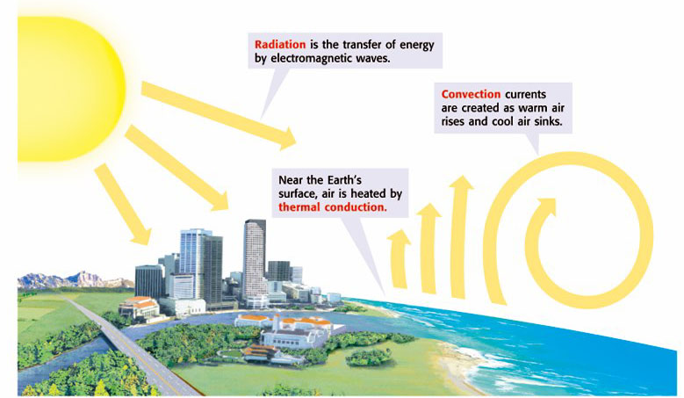
Section 2
Radiation, Conduction, and Convection
Copyright © by Holt, Rinehart and Winston. All rights reserved.
Notes:
Header first line (section#) – white 24 points Arial Bold
Header second line (title) – white 28 points Arial Bold
Title – navy 28 points Arial Bold
Body text – black 24 points Arial and Arial Bold
Bullets – navy
Copyright – white 12 points Arial
Background name: HST-Presentation_white.jpg
Size:
Height: 7.52"
Width: 10.02"
Scale: 70%
Position on slide:
Horizontal - 0"
Vertical - 0"

Slide 49
What causes air to move?
Differences in Air Pressure & Temperature!
caused by
1. Uneven heating of the Earth
causes some places to be cold & some to be hot
2. Convection Currents
Heated air = less dense air = it rises = low pressure area
Cooled air = more dense = it sinks = high pressure area
Air moves from areas of high pressure to low pressure

Slide 50
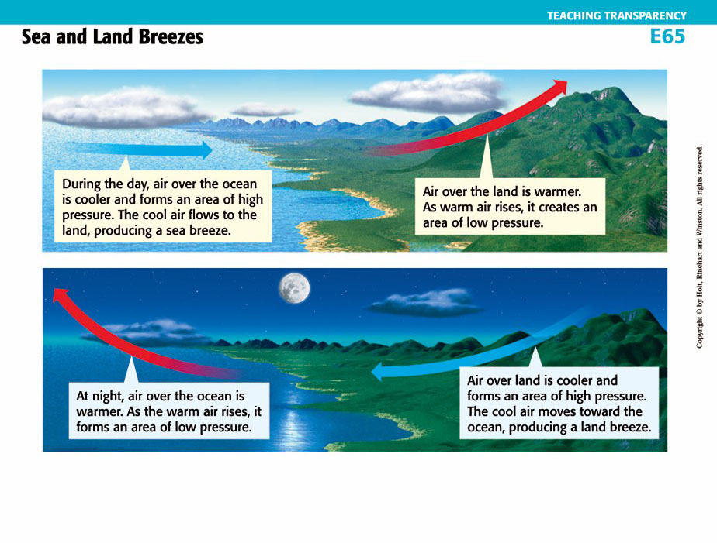
Sea & Land Breezes

Slide 51
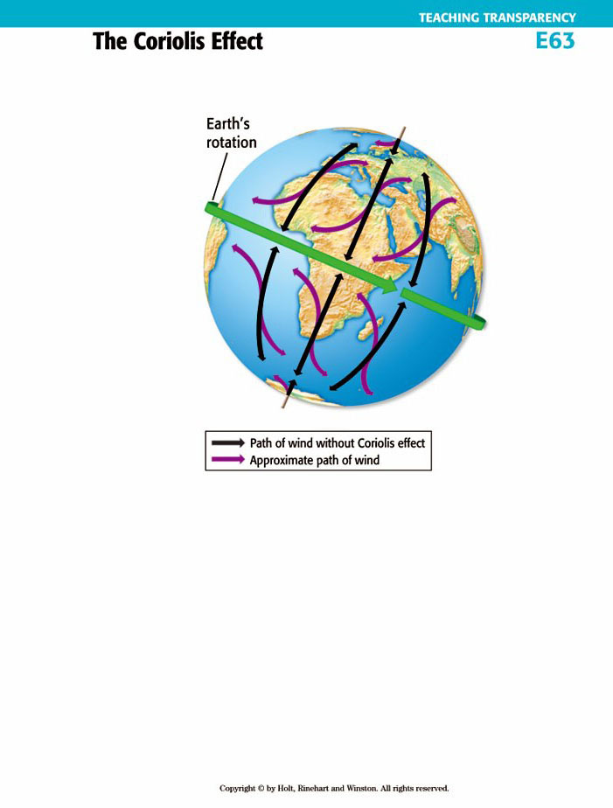

The Coriolis Effect
The apparent curving of the path of currents due to the Earth’s rotation

Slide 52

Climate is affected by:
Latitude
Wind patterns
Mountains
Large bodies of water
Ocean currents

