Slide 1
Opening Assignment
Which of the following is an example of a physical change ?
A. lighting a match
B. breaking a glass
C. burning of gasoline
D. rusting of iron
WHY? __________________

Slide 2
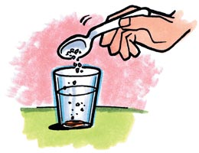
Physical or Chemical Change?
Dissolving salt in water?

Slide 3
Review – Describing matter
Foldable…..

Slide 4
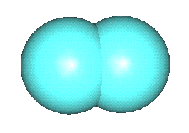
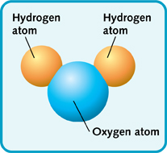
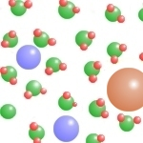
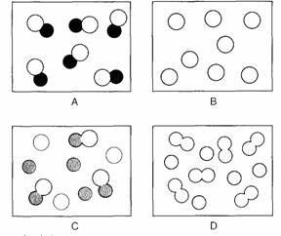
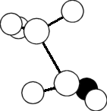
Elements compounds and mixtures!

Slide 5
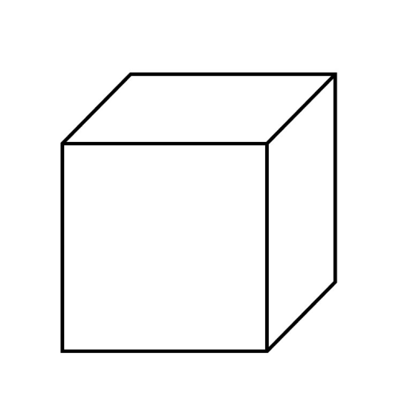
Square 1
Write down as many examples of elements that you can!
Its timed!!!!!
Draw a cube of aluminum… What would it look like if you put on your molecular goggles?

Slide 6
4. What is the smallest particle of the element gold (Au) that can still be classified as gold?
A. atom
B. molecule
C. neutron
D. proton
5. What is the smallest unit of a compound that still can be classified as a compound?
A. atom
B. molecule
C. neutron
D. proton

Slide 7
Square 2
Draw a compound
What is the chemical formula for the compound?

Slide 8
7. A scientist combines oxygen and hydrogen to form water. This combination illustrates that water is
A. an atom
B. an element
c. a mixture
d. a compound
8. Which of the following is formed when two elements combine chemically
A. An atom
B. a compound
C. an electron
D. a mixture

Slide 9
Square 3
Draw the smallest unit of the compound water.
Label the atoms.
What is this called?

Slide 10
What is the smallest unit of a chemical compound that still has the properties of that compound?
nucleus
molecule
atom
element

Slide 11
Square 4
Air is a mixture…..
Draw a mixture (of air!)
Label the atoms and molecules

Slide 13
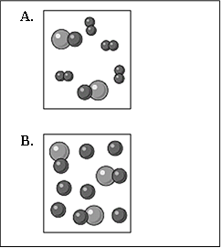
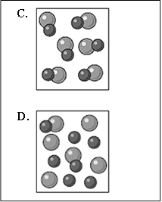
Square 5
Write down 2 examples pure substances.
Which of these is a pure substance?

Slide 15
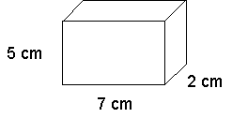
Square 6 What is volume?
What is the volume of this cube?
If it had a mass of 35 grams what would be its density?

Slide 16
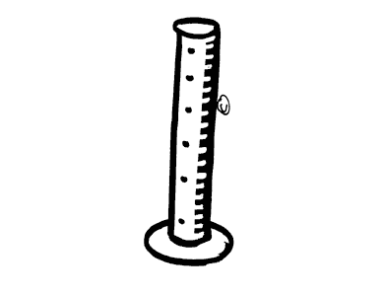
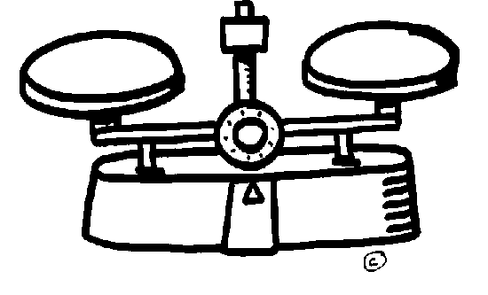
Square

Slide 17
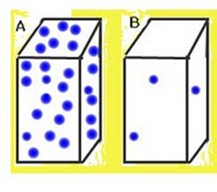
Density Which is more dense?

Slide 19
Formula for density
What is the density of an object that has a mass of 10 grams and a volume of 5 cm³

Slide 20
Which of the following units best represents the density of an object?
kg
hr
m/s²
g/cm³

